Slide 1
Twelve-Factor App Methodology

Slide 2
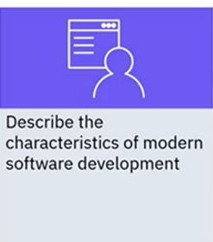
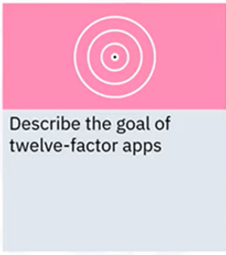
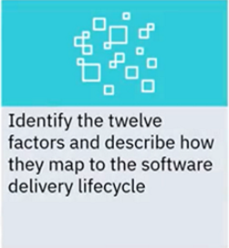
What you will learn

Slide 3

Modern software development
• Delivered as a service
• Centrally hosted and accessed through the
internet
• Web apps, software-as-a-service (SaaS)
• Twelve-factor app methodology is suited for
web apps
• Frequently used with microservices

Slide 4
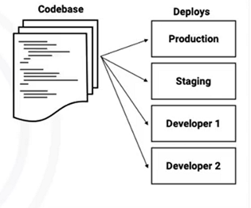
Code factors
Factor 1: Codebase
• Track in a version control system (VCS)
• Maintain one-to-one relationship
between codebase and app
• Deploy multiple instances of the app
• Develop different versions of the
codebase in each deploy

Slide 5
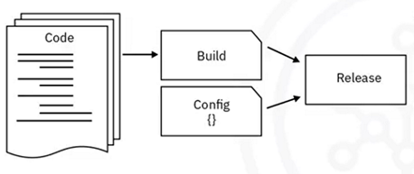
Code factors
Factor 5: Build, release, run
• Build: Transform a codebase
into an executable unit called
a build
• Release: Combine build with
configuration so that it’s
ready for execution
• Run: Run the application
All three stages should be strictly separated

Slide 6

Code factors
Factor 10: Dev/prod parity
• Minimize differences
between development and
production environments
• Use same backend services
across environments

Slide 7

Code factors
Factor 2: Dependencies
• Assume an app is only as
reliable as its least reliable
dependency
• Explicitly declare any
dependencies

Slide 8

Deploy factors
Factor 3: Config
• Keep everything that varies
between deploys such as
credentials and backend
service locations in config
• Keep separate from the code
• Store config in environment
variables

Slide 9
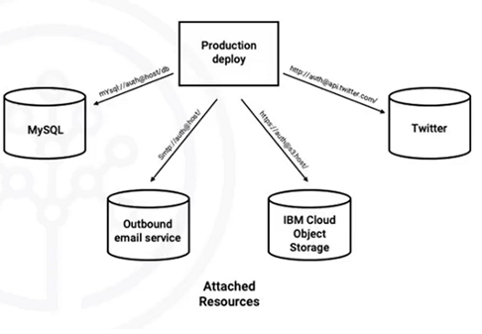
Deploy factors
Factor 4: Backend services
• Do not distinguish between
local and third-party
services
• Access alL services by a
URL and credentials so
that they can be swapped
without changing the code

Slide 10
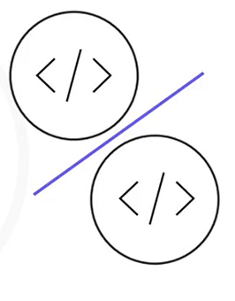
Deploy factors
Factor 6: Processes
• Should be stateless and
share nothing
• Do not share memory and
filesystems so persistent data
stored in backend service
• Store data centrally

Slide 11

Deploy factors
Factor 7: Port binding
• Export services by port binding
• Export HTTP and other services
• Declare a web server library dependency
• Become backend services for other apps

Slide 12
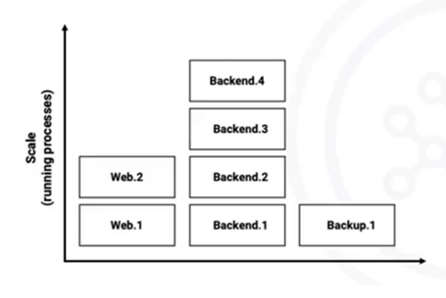
Operate factors
Factor 8: Concurrency
• Scale an application
• Stateless processes can be
spun up without creating
dependencies on other
processes

Slide 13

Operate factors
Factor 9: Disposability
• Require minimal process
start time and graceful
termination
• Quickly deploy code or config
changes
• Easily scale apps

Slide 14
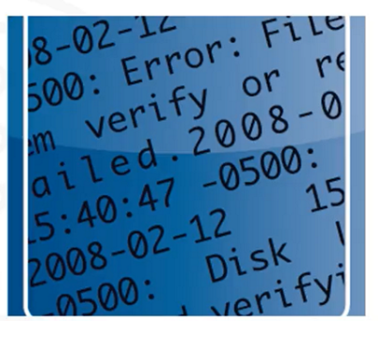
Operate factors
Factor 11: Logs
• App should not concern itself
with storing logs
• Treat logs as an event stream
• Execution environment
captures, aggregates, and
routes Logs to their
destination

Slide 15
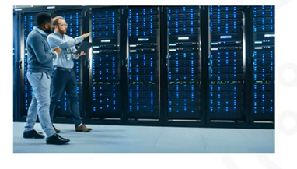
Operate factors
Factor 12: Admin processes
• Enable one-off app
management processes
• Run against a release, using
same codebase and config
• Part of application code

Slide 16
Recap
In this video, you Learned that:
• Modern software development often delivers centrally hosted,
web-based, SaaS applications
• Twelve-factor app methodology enables developers to create
more efficient SaaS applications
• The twelve factors map to the code, deploy, and operate stages
of the software delivery lifecycle

